Slide 1
EDI: Electronic Data Interchange
What is EDI?
  Exchange of electronic data between companies using precisely defined transactions
  Set of hardware, software, and standards that accommodate the EDI process

Slide 2
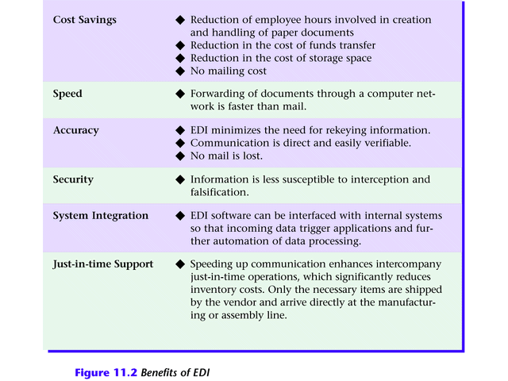
Electronic Data Interchange
Figure 11.2 Benefits of EDI

Slide 3
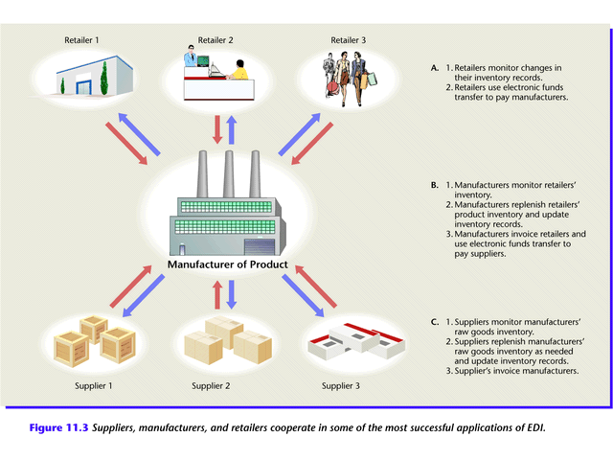
Electronic Data Interchange
Figure 11.3 Suppliers, manufacturers, and retailers cooperate in some of the most successful applications of EDI.

Slide 4
Electronic Data Exchange
How does EDI work? (Figure 11.4)
  Supplier’s proposal sent electronically to purchasing organization.
  Electronic contract approved over network.
  Supplier manufactures and packages goods, attaching shipping data recorded on a bar code.
  Quantities shipped and prices entered in system and flowed to invoicing program; invoices transmitted to purchasing organization

Slide 5
Electronic Data Exchange
  Manufacturer ships order.
  Shipment notice EDI transaction sent (not shown)
  Purchasing organization receives packages, scans bar code, and compares data to invoices actual items received.
  Payment approval transferred electronically.
  Bank transfers funds from purchaser to supplier’s account using electronic fund transfer (EFT).

Slide 6
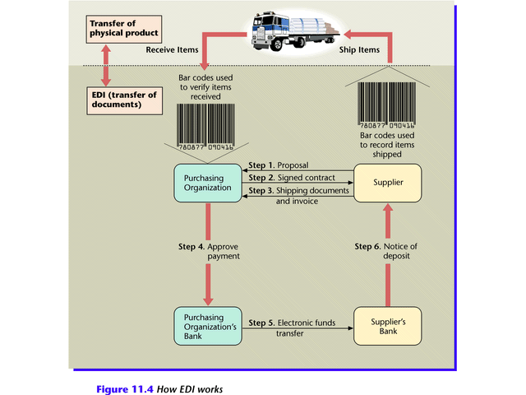
Electronic Data Interchange
Figure 11.4

Slide 7
Electronic Data Interchange
EDI Standards
  EDI requires companies to agree on standards
    Compatible hardware and software
    Agreed upon electronic form format
  Established EDI standards
    Automotive Industry Action Group (AIAG)
    X.12 de facto umbrella standard in U.S. and Canada
    EDI for Administration, Commerce, and Trade (EDIFACT) umbrella of standards in Europe

Slide 8
Electronic Data Interchange
How to Subscribe to EDI
  Larger companies purchase hardware and software
  Medium and small companies seek third-party service
    Value-added networking (VAN)
    Managed network services available for a fee

Slide 9
Electronic Data Interchange
EDI on the Web
  Advantages of Web EDI
    Lower cost
    More familiar software
    Worldwide connectivity
  Disadvantages of Web EDI
    Low speed
    Poor security

Slide 10
Electronic Data Interchange
The Importance of EDI
  Need for timely, reliable data exchange in response to rapidly changing markets
  Emergence of standards and guidelines
  Spread of information into many organizational units
  Greater reliability of information technology
  Globalization of organizations

